Slide 1

Data-Driven Insights to Improve User Conversion at Wolt
This presentation explores user behavior to identify key conversion drivers. Analyzing data from September 2019 to October 2020, we uncover actionable insights to optimize the Wolt user journey and boost conversion rates.
By : Uzer Ahmed

Slide 2
Project Overview: Data and Scope
Objective
Dataset
Analyze user behavior post-signup to identify conversion drivers.
New customers registered in September 2019.
Activity tracked for one year.
Scope
Target
September 2019 signups to October 2020 user activity.
Whether the user made a purchase.

Slide 3
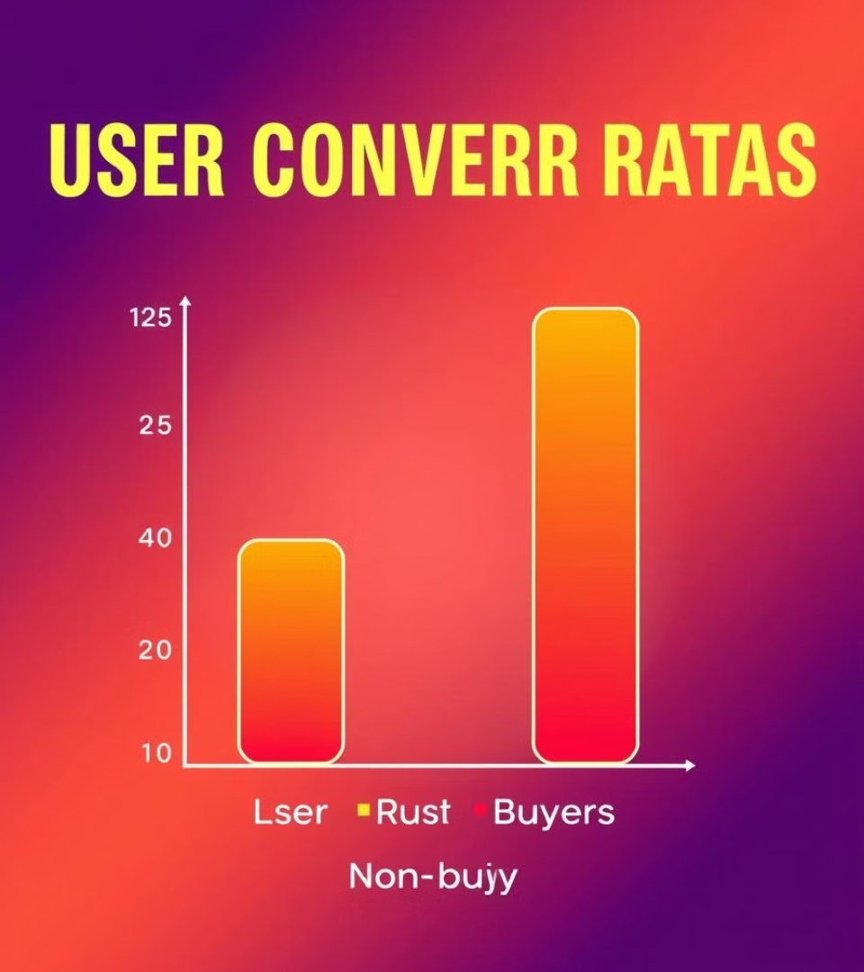
User Conversion Overview
22K
Total Users
New customers from Sept 2019.
45%
Purchasers
Users who made at least one order.
55%
Non-Purchasers
Users who signed up but never ordered.
A significant portion of users sign up, but don't convert to paying customers.

Slide 4
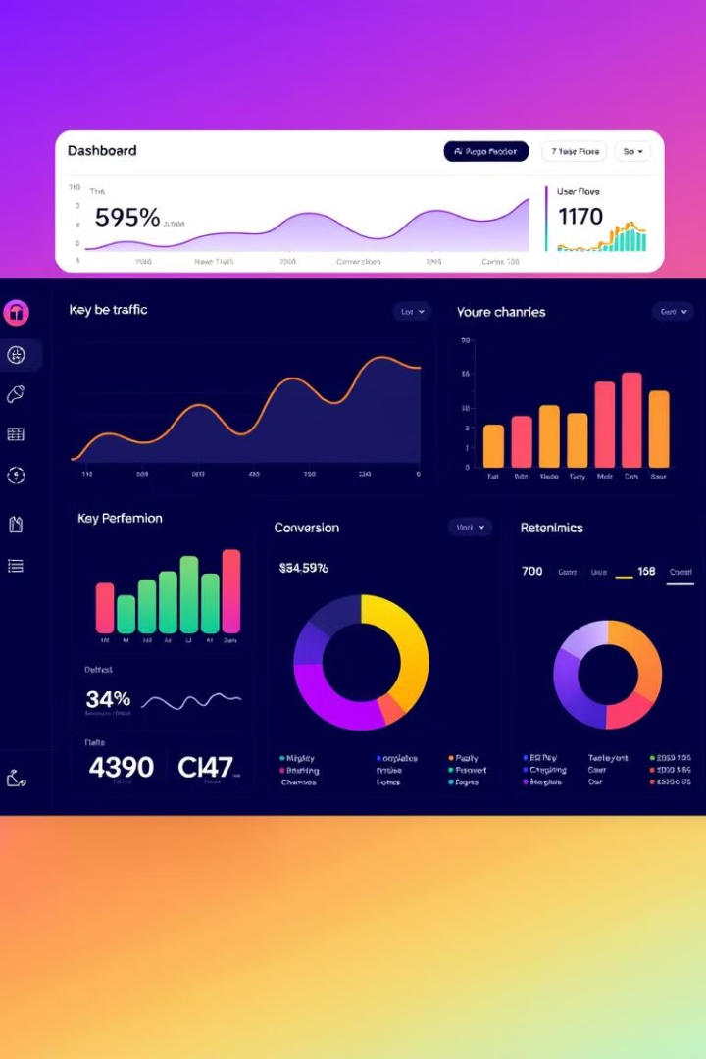
Key Metrics to Track
1
Conversion Rate
By device & region.
2
Time to First Purchase
Indicates onboarding friction.
3
Purchase Frequency
Orders per user.
4
Retention Rate
7/30/90 day retention.

Slide 5




Key Behavioral Insights
Mobile Users
Evening Signups
Regional Skew
Converted faster.
Higher conversion rates.
High-conversion zones.
Optimizing for mobile users and capitalizing on evening signups in specific regions can significantly improve conversion.

Slide 6




Predictive Indicators of Conversion
Early Activity
Activity within first 7 days.
Number of Sessions
Total sessions within first month.
Signup Device
Device used during signup.
Early engagement, session frequency, and the type of device used at signup are strong indicators of future conversion.

Slide 7
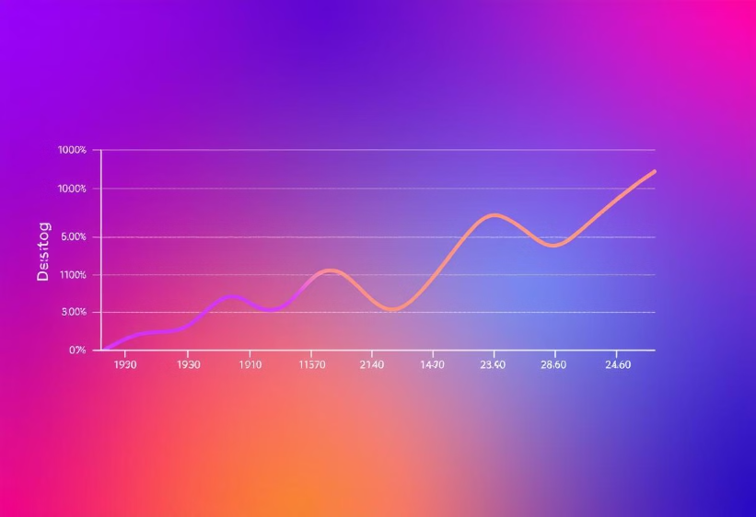
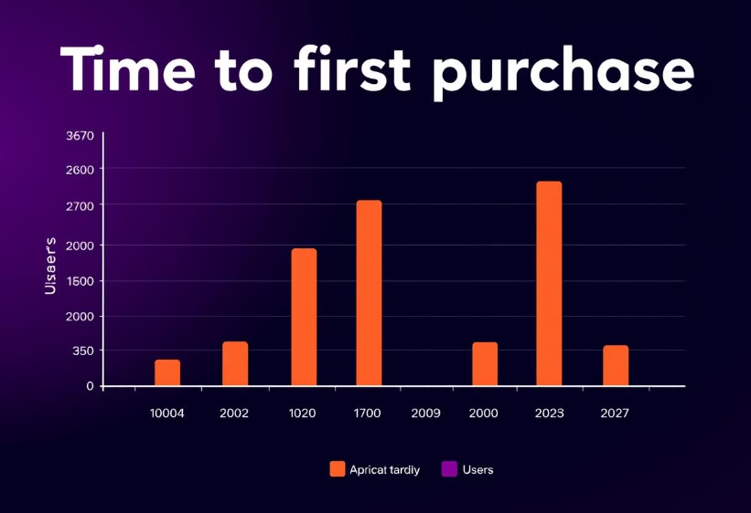
Visualizing User Behavior
Device Conversion
Time to Purchase
Distribution by device type.
Histogram of first purchase time.

Slide 8
Business Recommendations
Onboarding Optimization
1
Improve first 7 days.
Mobile Campaigns
2
Incentivize first mobile purchase.
Targeted Groups
3
Based on signup patterns.
Improving onboarding, incentivizing mobile orders, and targeting specific user groups are key to increasing conversion.

Slide 9

Summary: Key Takeaways
Early Activity
User Segmentation
Strong conversion signal.
Device/time adds targeting power.
Conversion Pipeline
Optimize via experimentation.
Focusing on early activity, segmenting users, and optimizing the conversion pipeline will drive significant improvements.

Slide 10

Next Steps: Action Items
Test Onboarding
Implement A/B tests.
1
2
Refine Model
Add more user touchpoints.
Moving forward, we will implement A/B tests to optimize onboarding and refine the predictive model with more data points.

